Slide 1


Unstructured and External Data
Selected Examples with References

Slide 2
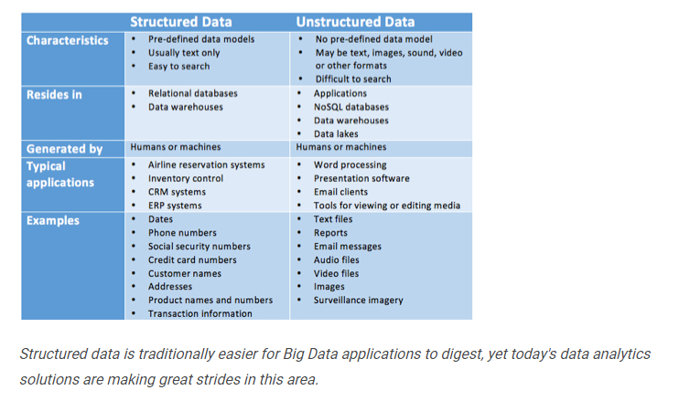
Good side-by-side comparison of
structured and unstructured data
https://www.datamation.com/big-data/structured-vs-unstructured-data.html

Slide 3
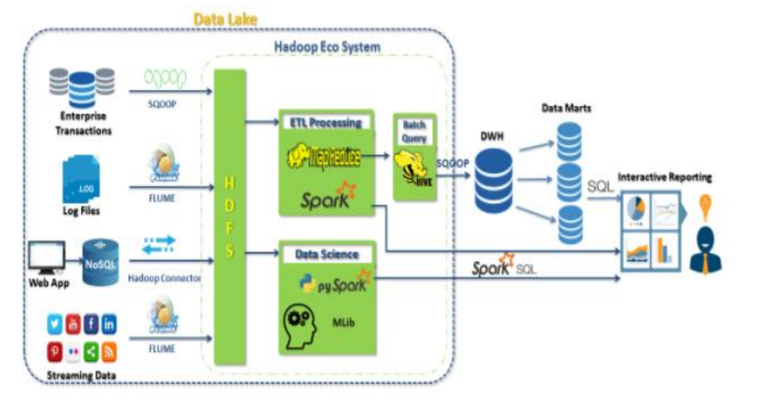
Data Lakes are very popular. Using a design
similar to what you see here, both unstructured
and structured data can be leveraged. In this
Example it is upstream of the data warehouse.
https://www.datasciencecentral.com/profiles/blogs/beyond-datawarehouse-the-data-lake

Slide 4
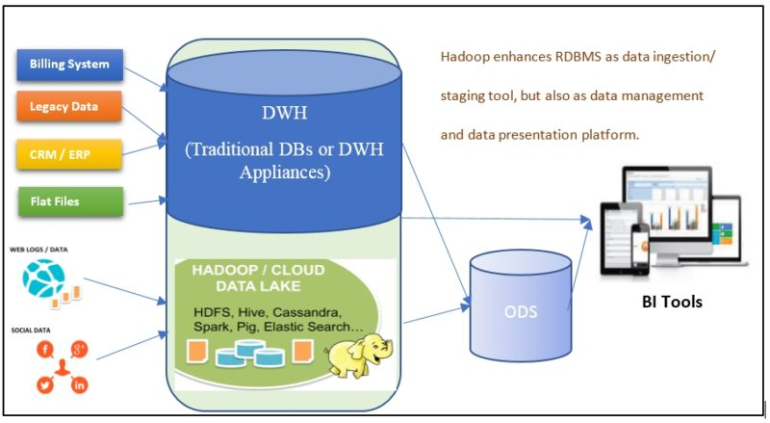
Here you can see
it coexisting with a
traditional warehouse
https://blogs.mastechinfotrellis.com/can-big-data-replace-edw

Slide 5
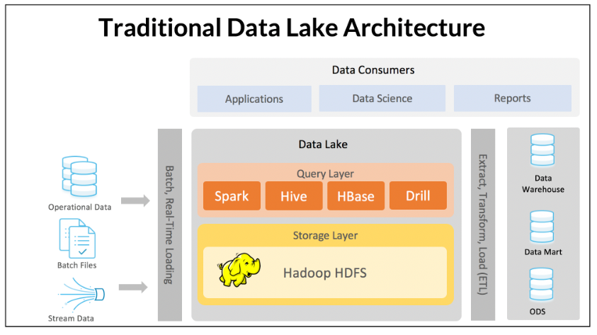
Warning: Heavily influenced by the memSQL vendor
https://www.memsql.com/blog/webinar-data-lake-age-of-ml-ai/

Slide 6
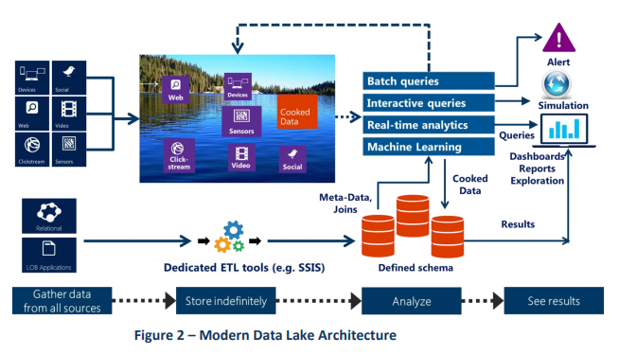
Warning: Heavily influenced by the vendor. Still a good reference for data lakes in Azure
http://innolitica.com/wp-content/uploads/2013/04/White_Paper_Azure_Data_Lake_Store_Innolitica_Labs.pdf

Slide 7
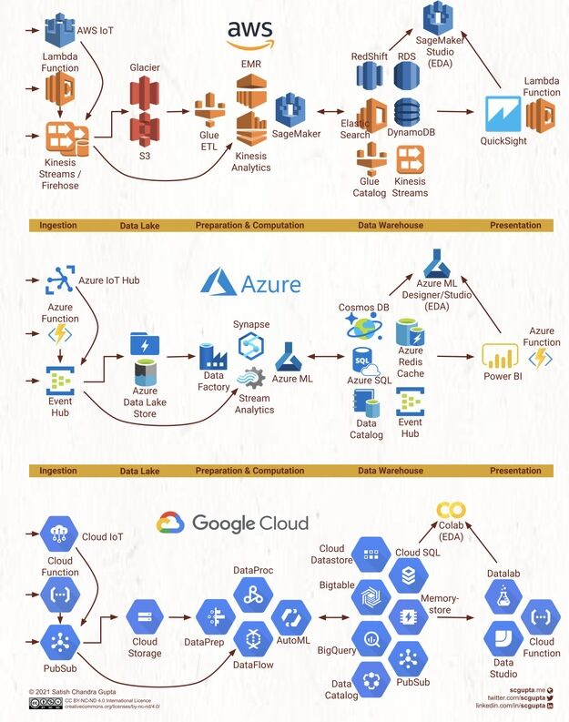
Written Assignment
What are some of the challenges of including external data?
Crossing vendors (AWS and Azure)
On-Prem and Cloud
Validation / Quality / Data Lineage / ETL vs. ELT
Strengths / weaknesses of storing external data in a data lake
Replicate the data
How often to copy it (real time, batch, etc.)
Think about the REQUIREMENT. Do you need more frequent (operational) or less frequent (trending)
Explain some of the differences between storing this type of data within a structured environment such as a data warehouse and a more flexible data lake paradigm.
Start with the type of data you have
Which solution offers the best
What is driving your decision (cost, capability, agility)

